Slide 1

scRNAseq
Jose Alejandro Romero Herrera
2021/12/02

Slide 2
Agenda. Postprocessing
Quality control
Dimensionality reduction and Visualization
R language-Seurat
Clustering
Batch correction
DEG analysis
GREAT, PANTHER, GOrilla, DAVID
GO-term and pathway analysis
Diffusion maps/Slingshot
Pseudotime
Notes:
Glossary of single cell terms: https://nbisweden.github.io/single-cell-pbl/glossary_of_terms_single_cell.html
R language: https://www.r-project.org/ https://rstudio.com/
Seurat: https://satijalab.org/seurat/
GREAT: http://great.stanford.edu/public/html/
PANTHER: http://www.pantherdb.org/
GOrilla: http://cbl-gorilla.cs.technion.ac.il/
DAVID: https://david.ncifcrf.gov/
Diffusion maps: https://www.sciencedirect.com/science/article/pii/S1063520306000546
Slingshot: https://bmcgenomics.biomedcentral.com/articles/10.1186/s12864-018-4772-0

Slide 3
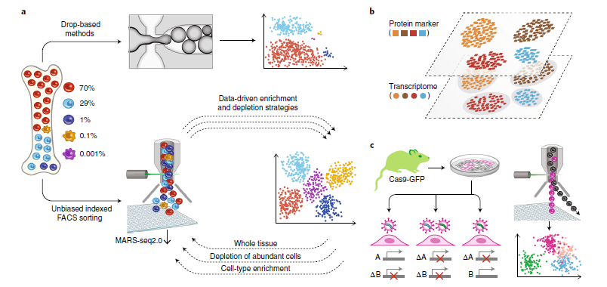
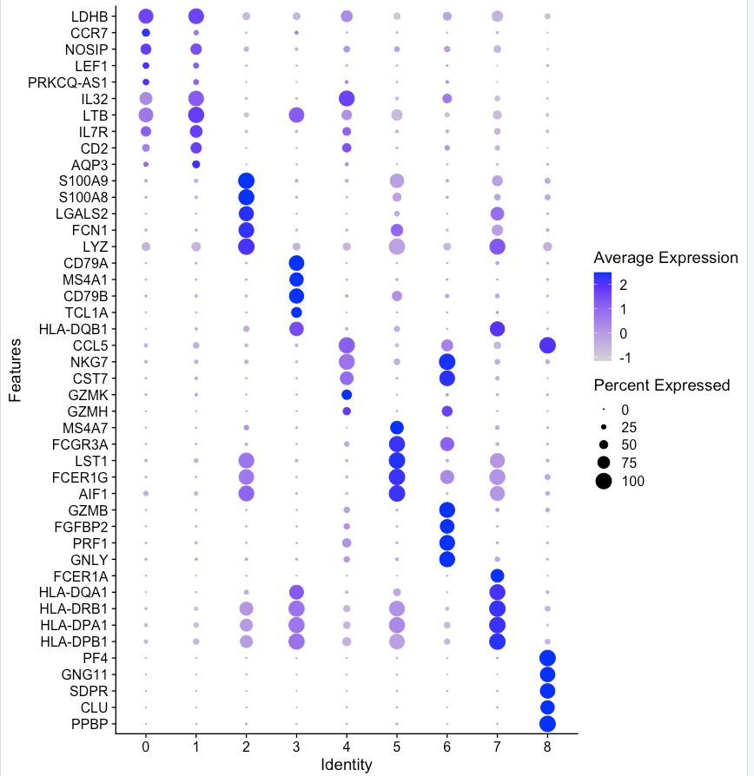
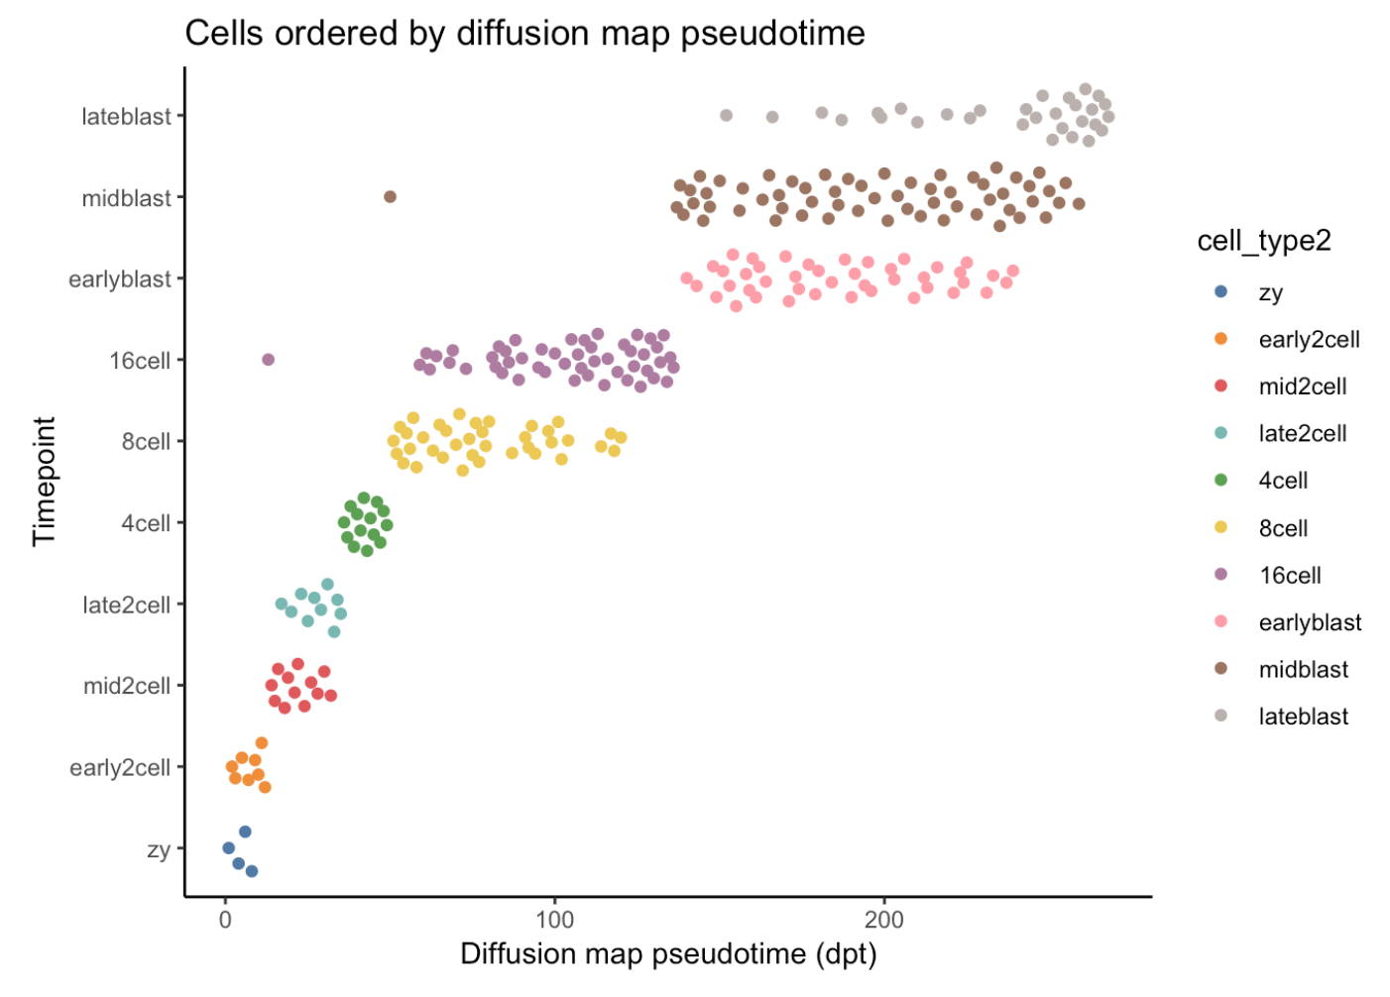
Workflow
Batch correction
QC
SC experiment
DE
Enrichment analysis
Clustering
Dimensionality reduction
Visualization
Pseudotime

Slide 4
Pseudotime or Cell Trajectories
Computationally order cells along trajectories, allowing the unbiased study of cellular dynamic processes
Very useful in differentiation processes or time-series analysis
It is a relatively new concept applied to single cell:
Many different tools and methods are developed and applied

Slide 5
Pseudotime or Cell Trajectories
Cell state 0
Cell state 1
Cell state 2
Cell state 3
Cell state 4
Differentiation
Day 0
Day 1
Day 2
Day 4
Day 8
Treatment
Timepoints
Pseudotime
0
1

Slide 6
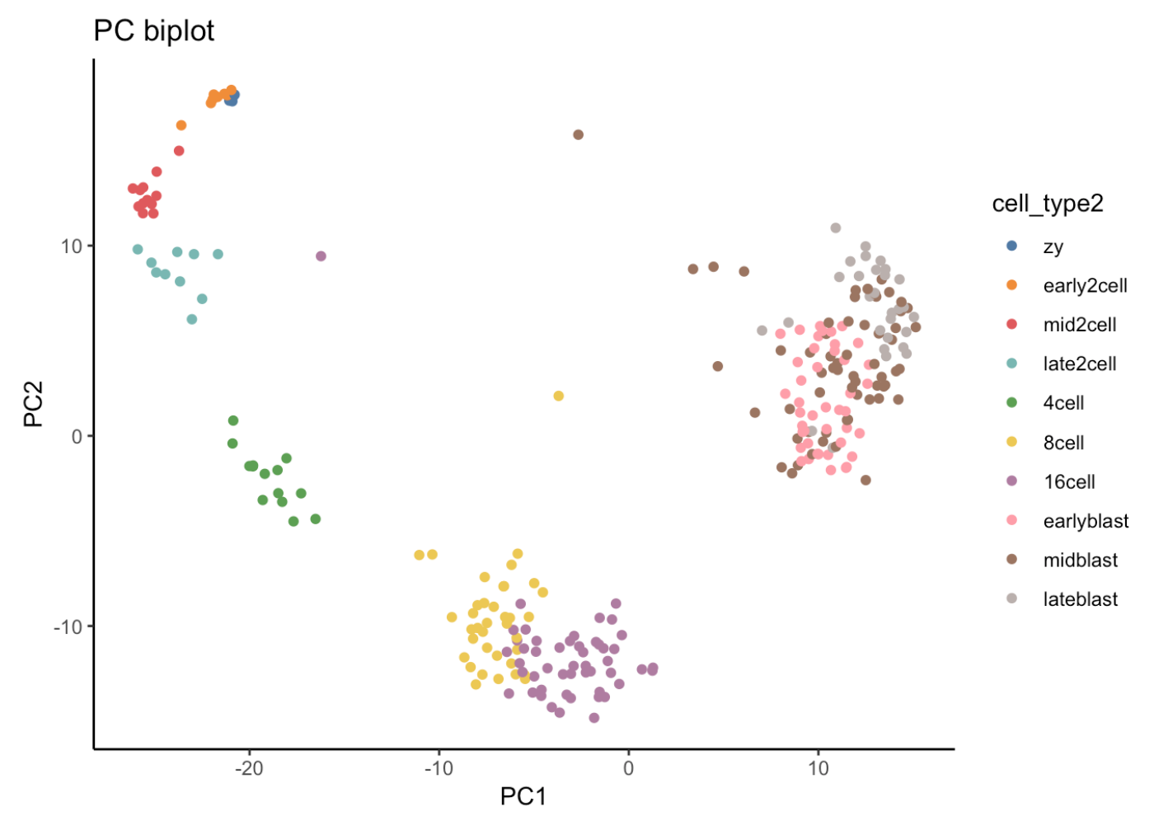
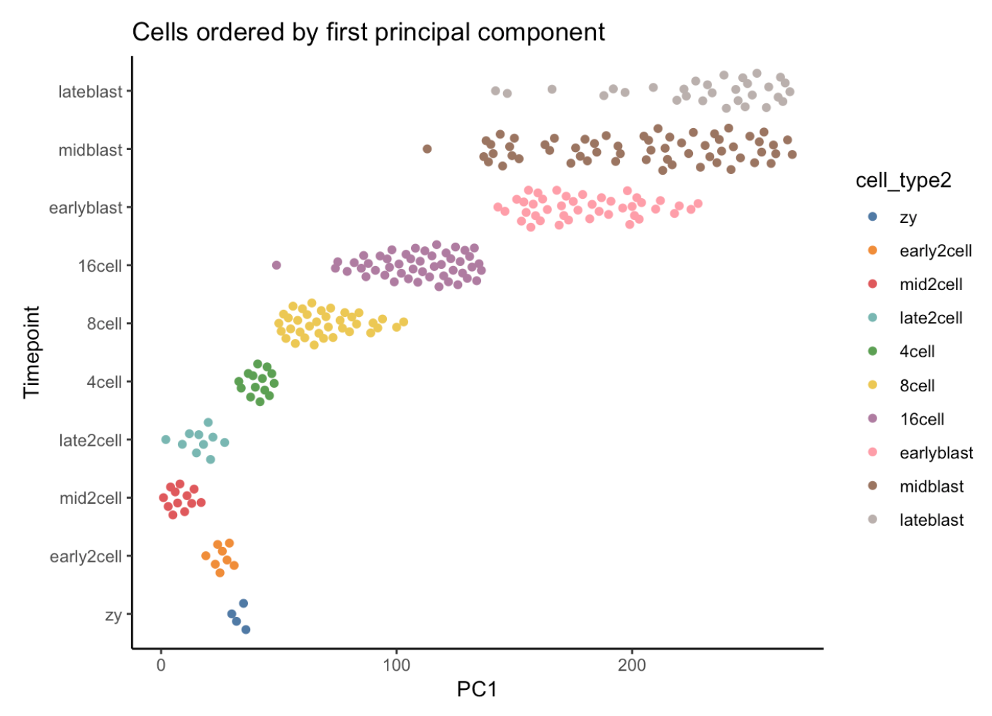
Pseudotime or Cell Trajectories. PCA
PCA is able to roughly represent differentiation process

Slide 7
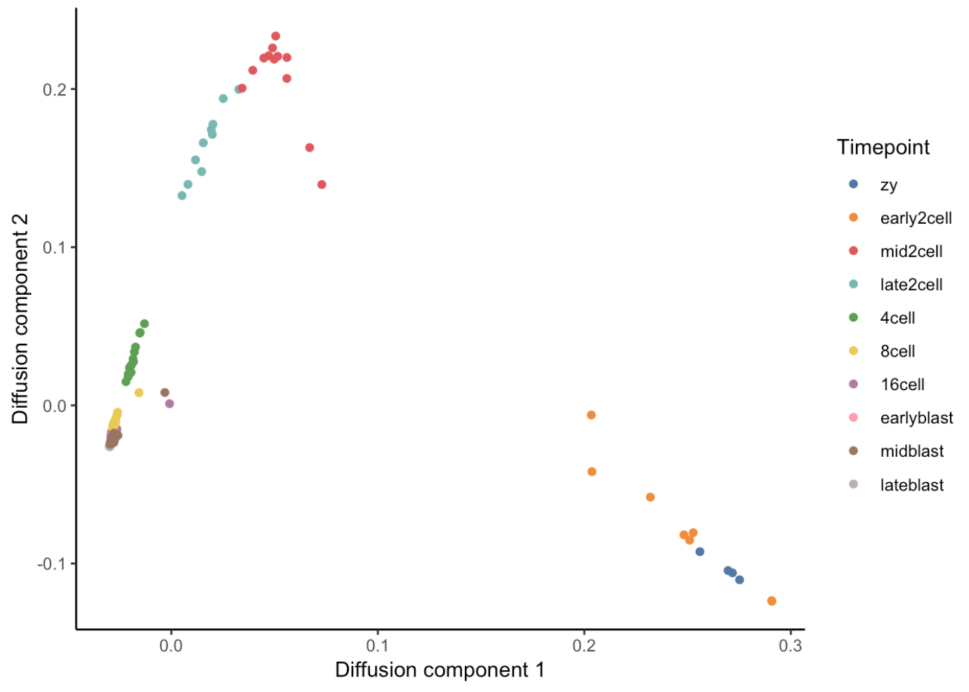
Pseudotime for early development. Diffusion pseudotime
Diffusion maps assume that the data is part of a diffusion process
From the diffusion components, a “pseudotime” can be estimated

Slide 8
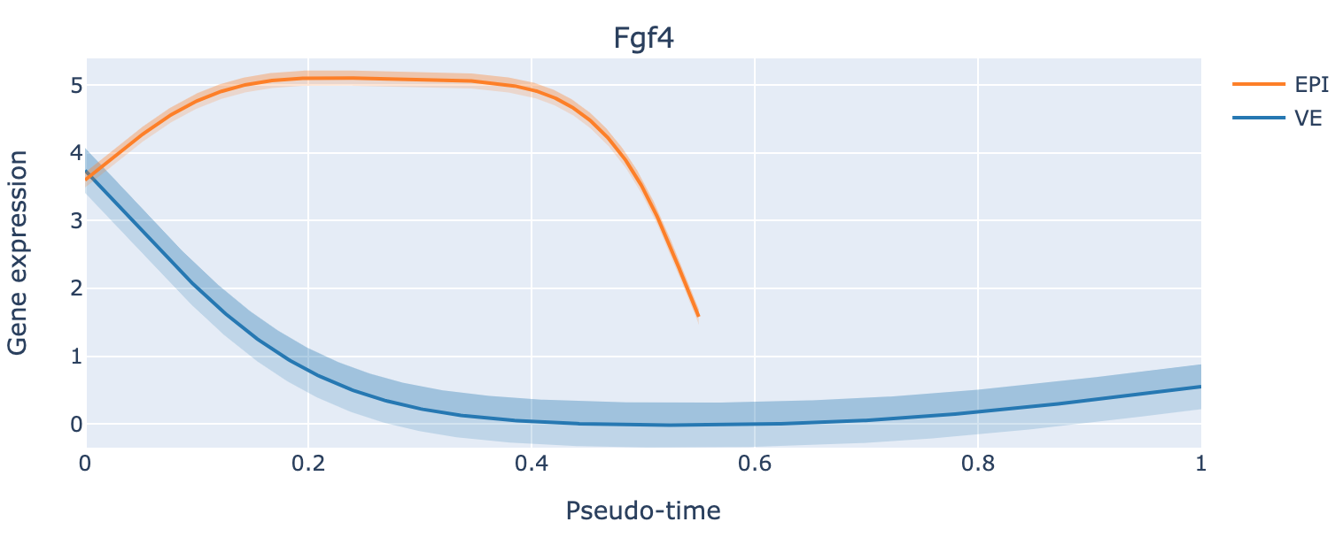
Pseudotime for early development. Notes
It is possible to visualize expression changes through pseudotime
Notes:
Put a wrap up

Slide 9
Pseudotime for early development. Notes
Most pseudotime estimators need knowledge about the starting point
If you do not know it, the direction is arbitrary!
You will need to validate your differentiation process:
Complex tissues
Differentiation branches
Direction depends on you!

